Slide 1

Optimizing Instabasket Orders Fulfillment for MM&A Grocery Store Chain
2023 MMA Datathon - Team 8
Oct 6th, 2023 Prepared by Angelina Ayres, Lee Pham, Teresa Le

Slide 2
Executive Summary
Business Problem: Customer satisfaction and the in-shopping experience has been negatively impacted due to the increasing volume of Instabasket shoppers, and the number of aisles that Instabasket shoppers need to visit to fulfill their orders
Proposed Solution: Implement a dedicated "Instabasket Aisle" with carefully selected 1000 products.
Optimize for two key metrics:
the number of orders that utilize the aisle, and
the average % of items in each order that utilize in-aisle items
Opportunities:
Boosted Revenue: Enhancing order fulfillment efficiency can lead to increased revenue.
Improved Customer Satisfaction: Streamlining the Instabasket process will reduce negative shopping experiences
Projected vs. Actual Outcomes: Our initial projection aimed for optimization at 15%, but we achieved an impressive 51% improvement

Slide 3
Data Overview & Objectives
Source of Data:
University of Toronto, Rotman School of Business derived from Kaggle (Sept 2023 - Oct 2023)
Records of grocery shopping transactions fulfilled through the Instabasket App
987,259 items purchased and 9,584 orders
Business Objectives:
Optimize Instabasket Fulfillment
Minimize In-Store Traffic Impact
Increase Sales through Instabasket
Enhance Customer Loyalty
Model Objectives:
Create an Instabasket Aisle
Product Selection
Identify Substitutable Products
Improve Order Efficiency
Measure Business Impact
The data contained a total of 987,259 items, out of these items, there were 19,584 orders.
The average number of items in each order is 10 items.
Out of the 100% of the raw database that was provided, we were asked to reduce around a 97% of the total products in order to fit 3% of it in the instabasket aisle, this means roughly 1000 products in the aisle.

Slide 4
Assumptions & Constraints
Size of Instabasket Aisle: Only 1000 products can be included in total. (3% of the total)
Frozen Products: All items categorized under the 'Frozen' department are treated as frozen products. Only 100 frozen products can be included.
Refrigerated Products: Refrigerated products include items from the 'Dairy Eggs,' 'Meat Seafood,' and 'Refrigerated Beverages' departments. Only 100 refrigerated products can be included.
Data Cleaning: Orders with missing department or aisle information have been excluded from the analysis for accuracy.
Substitutions: Based on our comprehensive analysis of various datasets, particularly in high-demand departments like produce and dairy & eggs, we consistently observed that many products have suitable substitutes or equivalent alternatives available. This finding indicates that we have significant opportunities to offer customers alternative choices when specific items are unavailable, thereby enhancing their shopping experience and ensuring order fulfillment. Exploration in this regard would be helpful.
Notes:
Assumption #2 - Although some vegetables and deli items may be refrigerated in some grocery stores, others may not. For the sake of simplicity we excluded vegetables and deli items from refrigerated items.
Assumption #3 - Because some of our analysis involved things where having missing values would impact the analysis e.g. clustering, we chose to remove rows of orders and products that were missing the department and/or aisle name.

Slide 5
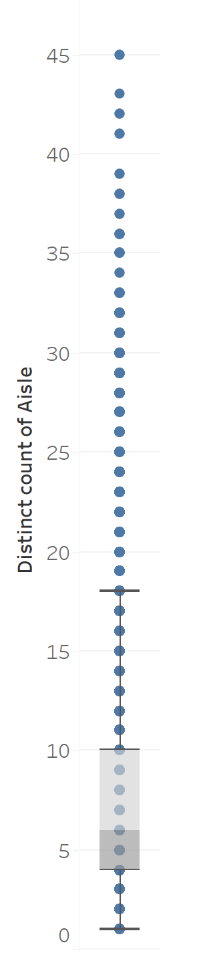
Trends in Aisles Usage
Most number of aisles used to complete order: 45
Least number of aisles used to complete order: 1
Median # of aisles used: 6
The chart reveals a positively skewed distribution in our aisle data. On average, customers navigate a reasonable number of aisles, typically around 6. However, it's important to note that some orders necessitate visits to an unusually high number of aisles. This insight highlights the need for strategic product placement within the Instabasket aisle to streamline order fulfillment, ensuring a smoother shopping experience for our customers.

Slide 6
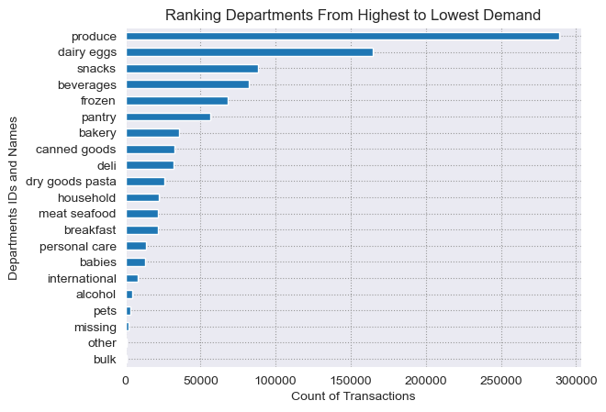
Most Popular Departments
Out of 21 departments, the Produce and Dairy Eggs departments have a significantly higher number of transactions which suggests that more priorities should be given to these departments in the Instabasket aisle to maximize order fulfillment.

Slide 7
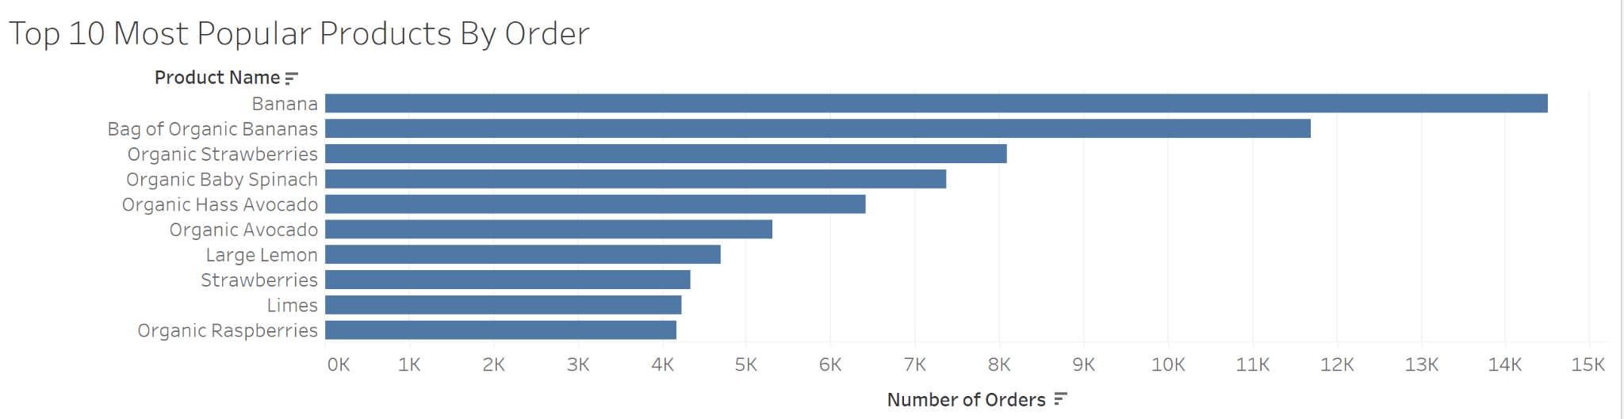
Most Popular Products Purchased
Consistent with the results for most popular departments, the most popular products that customers tend to include in their order fall under the department category ‘produce.’

Slide 8
Approach
Introduction to Product Popularity: Product popularity reflects the frequency of customer orders through our Instabasket platform, capturing their recurring purchase preferences. It's more than just product selection; it's a key driver of order fill-in.
In contrast to the conventional Pareto Principle, which emphasizes the top 20%, we've employed an innovative approach—an inverted Pareto strategy. Rather than focusing on the lower-performing 20%, we prioritize the essential 80%, specifically targeting the top 83% of products across categories, departments, aisles, and our entire product range.
By embracing this inverted Pareto 80/20 principle, concentrating on the most popular items within departments, aisles, and product names, we've significantly expanded our product coverage while maintaining a high fill-in rate, transcending the limitations of relying solely on product popularity.

Slide 9
Business Implications
Why It Matters to MM&A: Understanding and leveraging product popularity is central to our goal of optimizing Instabasket fulfillment.
Enhanced Customer Satisfaction: By ensuring that the most popular products are readily available and easily accessible to Instabasket personal shoppers, we can significantly improve the shopping experience for our customers. When customers find their favorite and frequently purchased items effortlessly, their satisfaction increases.
Operational Efficiency: Product popularity has a direct impact on the efficiency of order fulfillment. Placing the most popular items in the Instabasket Aisle reduces the time personal shoppers spend searching for these products in the store, resulting in quicker and more efficient order picking.
Maximizing Sales: Popular products are often the drivers of our sales revenue. By optimizing their availability, we can increase sales and revenue through both Instabasket and in-store customers.

Slide 10
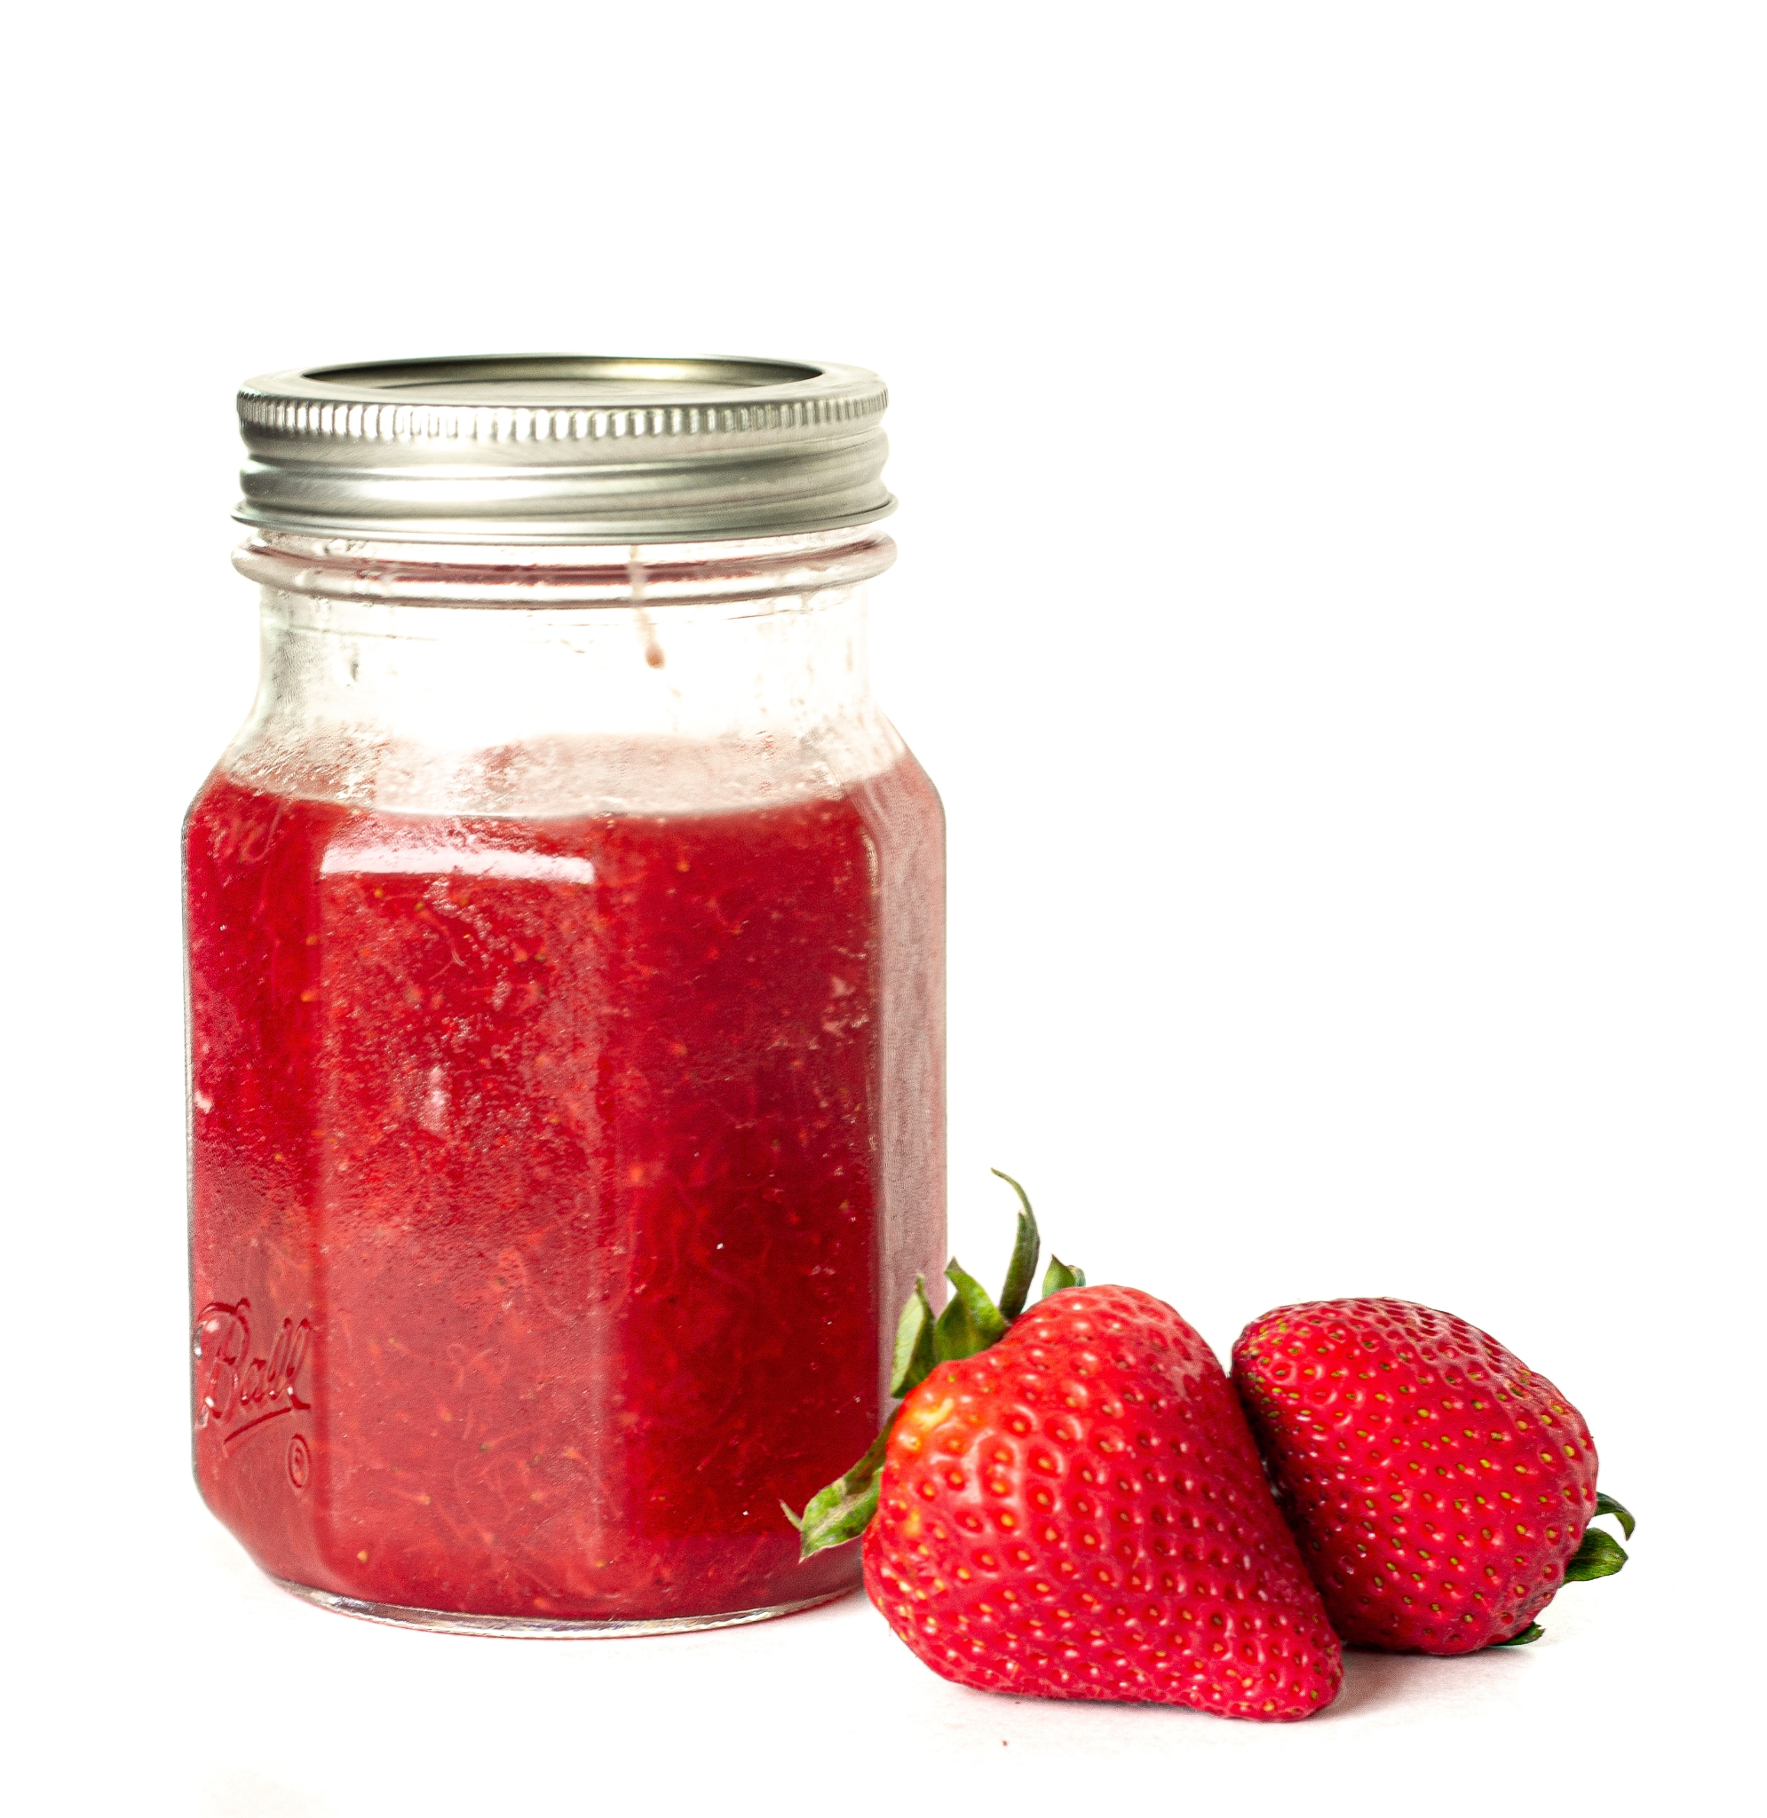

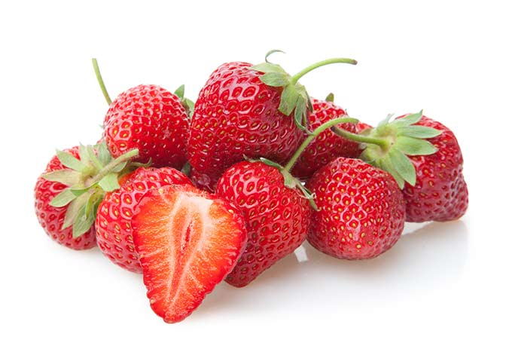
Substitutions - Re-categorize Items by Key Words
Organic Whole Strawberries
Frozen Department
Organic Strawberries
Produce Department
“strawberry”
Fruit Spread, Strawberry
Pantry Department
Organic Strawberry Smoothie
Dairy Eggs Department
Products with the same ingredient/flavour are more similar to each other than products within the same aisle or department.
Notes:
Despite being in a different department, these products all share one major ingredient: strawberries. They may be substitutes for each other too (i.e. frozen strawberries can be a close substitute for fresh strawberries).
Note that the stem word ‘strawberry’ is used here to overcome the differences between singular and plural nouns. Thereby, using word stems to group similar products together can narrow down the list products and serve to strengthen product selection diversity.

Slide 11
Expected Performance
Evaluating Performance Using Key Performance Indicators (KPIs)
Number of Orders that Utilize Instabasket Aisle (Order Fulfillment Rate): 48.7%
Average % of Products Use Instabasket Aisle: 89.3%
Customer Satisfaction: Measured through surveys or feedback to determine if customers are satisfied with substitutions and discounts
Examples of metrics and data to collect: How many items were ordered vs. how many were received, how many original items needed substitution, and how many orders were granted the 5% discount
Efficiency Gains: Reduction in Instabasket shopper time spent visiting aisles and searching for items leading to cost savings
Average time to do the shopping = 32 min
Based on this time, the assumed time that we would be saving is on average 15 min
On average, 3 aisles required to complete orders with Instabasket aisle vs. 6
Notes:
the number of orders that utilize the in-aisle items" - percent_order_fulfulfilled = fill-in-rate

Slide 12
Implementation
Customer Communication
Clearly communicate changes to customers, emphasizing benefits.
Simplify the process for customers to approve substitutions.
Performance Evaluation
Regularly assess the Instabasket Aisle's efficiency and customer satisfaction.
Adapt strategies for optimal results.
Cost-Benefit Analysis
Continuously analyze the financial impact to ensure cost-effectiveness.
Substitution Strategy Rollout
Identify commonly substituted products and train personal shoppers.
Offer a 5% discount to incentivize customers for substitutions.
Avoiding stock outs of most popular items & ensure they have proper substitutes.

Slide 13
Next steps
Business can retain more customers by ensuring that the services and products that the customer received are consistently convenient and timely. Customers should know what to expect from their deliveries which can be reinforced by the provision of accurate data in real-time.
Improve the data collection by including specific features for each product such as storage condition, flavour, etc. will enhance the the accuracies of substitute recommendations.
Introduce a standardized naming convention for the products to avoid repetitions of products with similar name.
A/B Testing for Effectiveness
Evaluate performance in selected stores with the Instabasket Aisle and the substitution strategy.
Monitor key metrics: order fulfillment rates, customer satisfaction, and in-store traffic.
Data-Driven Optimization
Continuously analyze customer behavior and preferences.
Adjust product selection and strategy based on data insights.
Customer Feedback Loop
Establish feedback channels to collect customer input.
Use feedback to refine the substitution strategy and product selection.
Instabasket Shopper Training
Train Instabasket shoppers to navigate the new aisle, handle substitutions and provide top-notch service.

Slide 14
Appendix

Slide 15
Appendix
References
https://www.bnnbloomberg.ca/how-fast-do-you-shop-canadians-average-32-minutes-at-grocery-store-study-finds-1.1171111

Slide 16
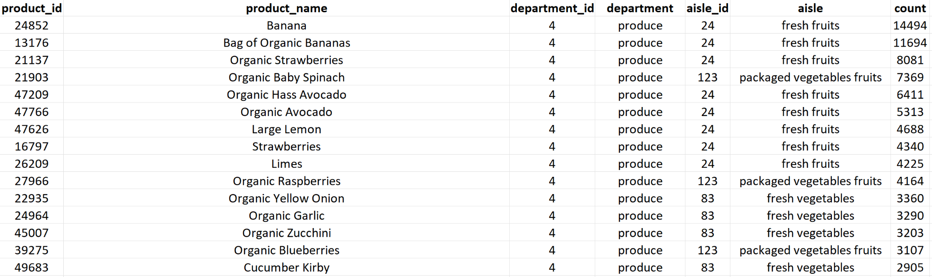
Appendix
Products Part of the Instabasket aisle
Link to the complete list of 1000 products selected

Slide 17
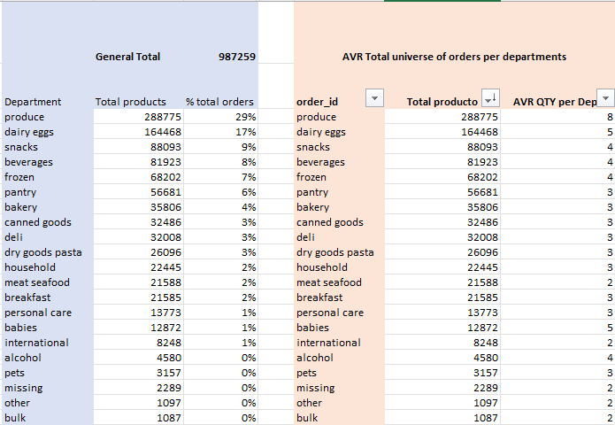
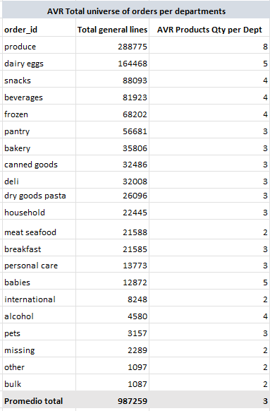
Appendix
Pareto 80/20 principle - application in excel pivot tables to determine selection
In order to perform a correct analysis using tools such as excel, one must firstly understand the data and its behaviour.
These preliminary tables calculate general metrics such as average amounts of product per department, average quantity of product in each department per order and the significance each department has in the orders. This shows us a trend and allows us to understand customer needs.

Slide 18
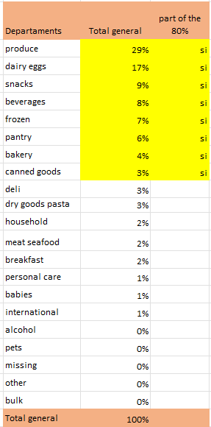
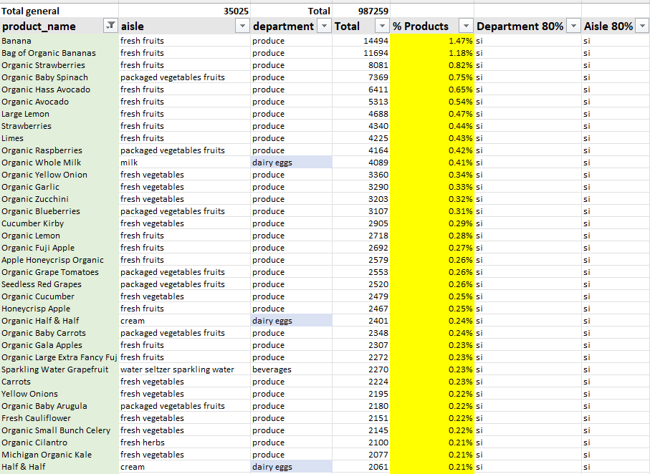
Appendix
Pareto 80/20 principle - application in excel pivot tables to determine selection
Once we have identified trends in consumer behaviour, we can start segmenting the top 83% of each category (department, aisle, product name).
Why did we invert the pareto principle and not take only 20% of the products, especially with only a limited space of 1000 products? This is due to the behaviours observed in previous tables, the heaviest departments are produce (29%), dairy eggs (17%) before jumping down to only a 9% of popularity in snacks.

Slide 19
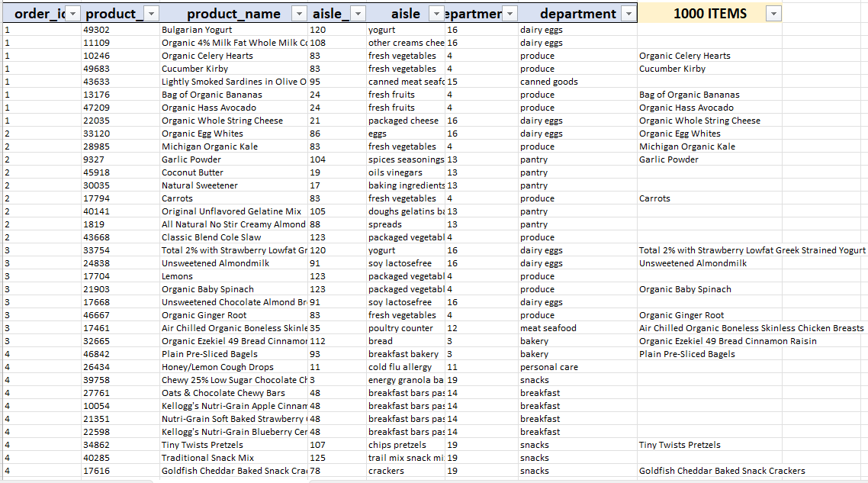
Appendix
Pareto 80/20 principle - application in excel pivot tables to determine selection
Once having identified the rough 83% proportionally in each category (detailed in yellow in the previous tables), we proceed to cross reference out of all our filters, which products have a yes in our 80% in department, aisle and name? It is important to note that not all items in the 1000 product list fulfill all 3 parameters, however, they were still selected due to the impact they have in their own category.
Finally we draw a comparison table of the whole DB vs our instabasket aisle list.

Slide 20
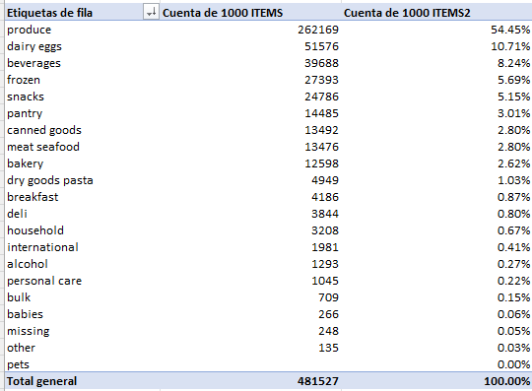

Appendix
Pareto 80/20 principle - application in excel pivot tables to determine selection
To end, we calculate fill-in rates based on the total count of items we have per department, as well as the projected weight they have in percentages.
Link to full excel workbook: https://docs.google.com/spreadsheets/d/1IWSGmPCSkKaij1wE9ZbulHheuoYzm1DQ/edit?usp=sharing&ouid=112415161488879273230&rtpof=true&sd=true

Slide 21
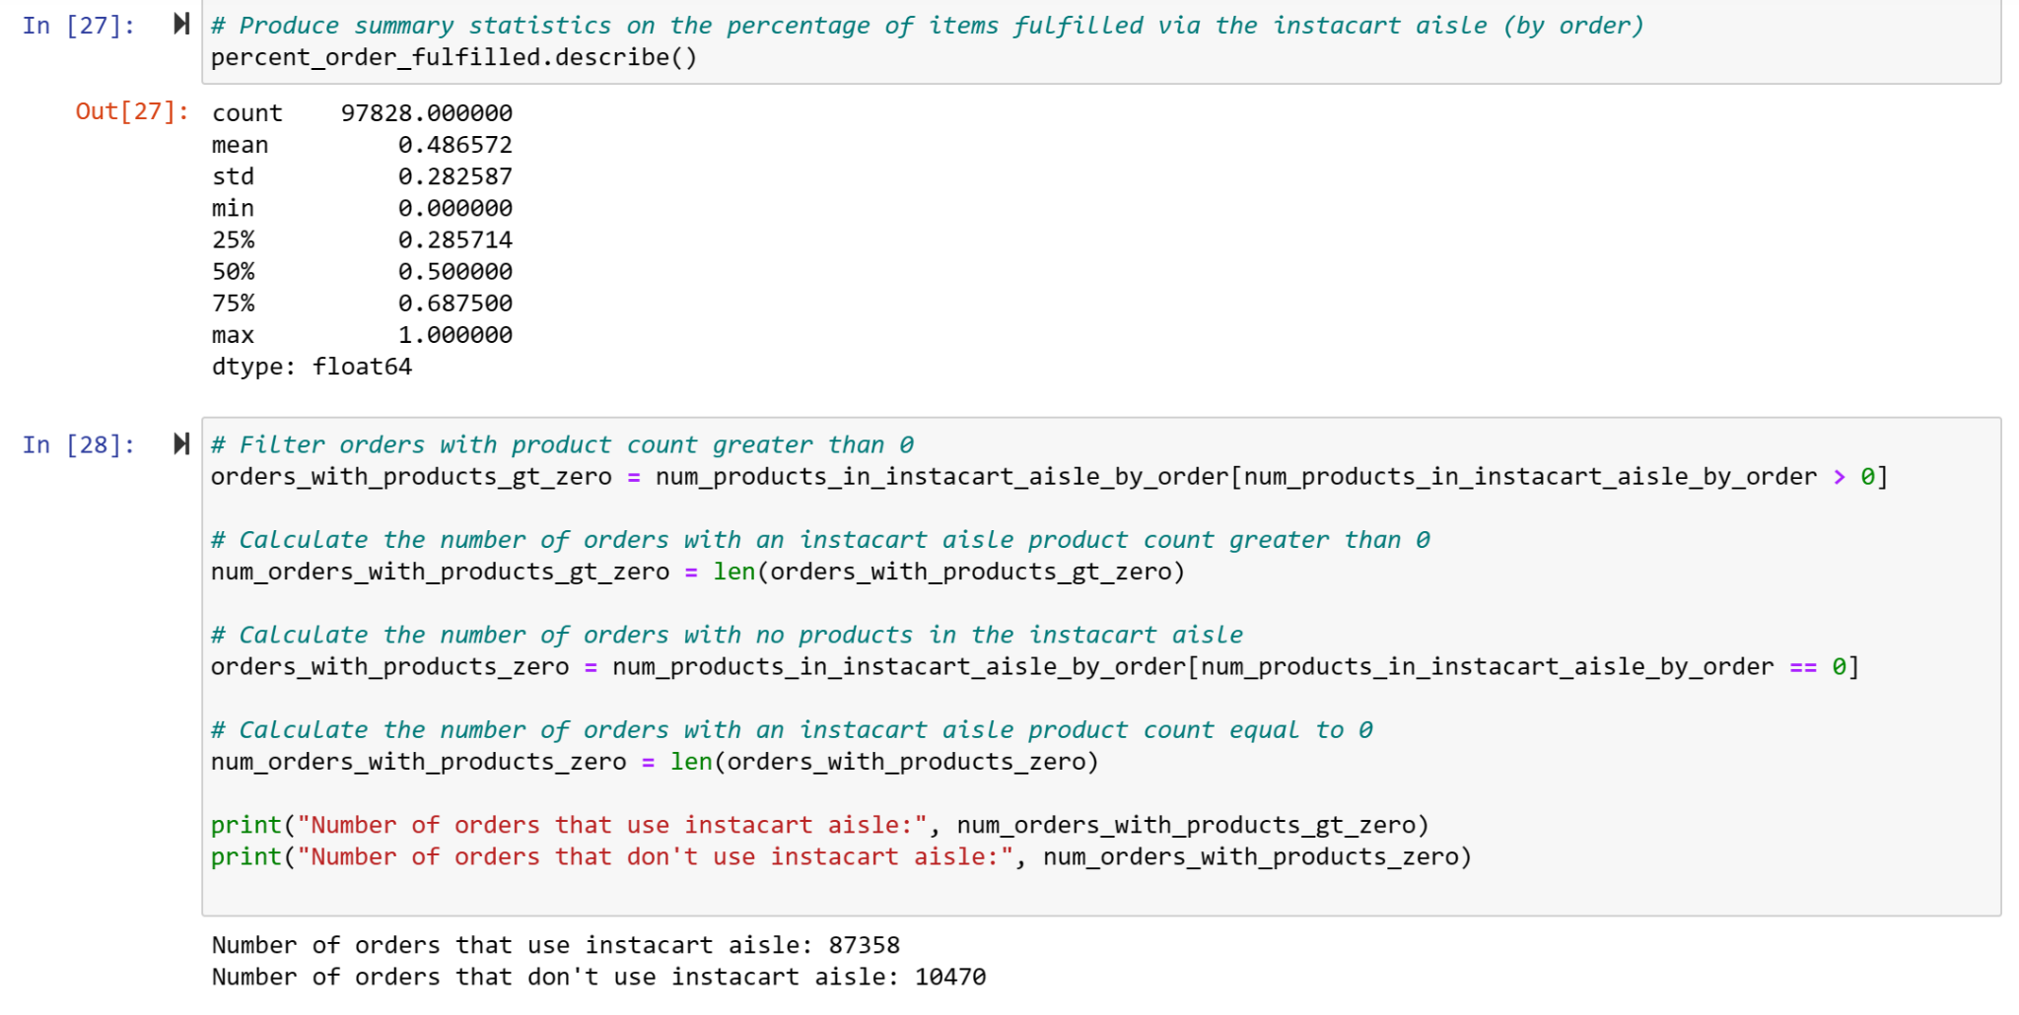
Appendix
Calculating the metrics via Python
Link to GitHub Jupyter Notebook calculating the metrics

Slide 22


